Slide 1
GNI Core Flexibility Report:
Ambition & approach for adaptive planning of the gas network
Please note, this session will be recorded
Joint webinar for stakeholders

Slide 2
Agenda
11:00 – 11:05: Welcome
11:05 – 11:10: GNI Core Flexibility Project Introduction
11:10 – 11:35: GNI Approach and Material for Consultation
11:35 – 11:40: Next Steps
11:40 – 12:00: Q&A Session

Slide 3
Webinar Introduction
The purpose of this webinar is to:
  Introduce the Core Flexibility Report
  Present the process of adaptive planning and GNI’s approach for the development of the first iteration and longer term road map
  Invite feedback and address questions from stakeholders on questionnaires circulated to date.
This stakeholder engagement process is your opportunity to provide input for the development of the Core Flexibility Report by giving:
  Insight into trigger points.
  Feedback on parameters used for our energy system models.

Slide 4
GNI Core Flexibility Report
Project Introduction

Slide 5
Background
The Price Control 5 (PC5) Decision set the revenues that GNI can collect from its customers from October 2022 to September 2027, together with the set of incentives and obligations placed upon GNI.
The CRU introduced the new Flexibility and Adaptability Incentive.
“The objective of this incentive is for GNI to demonstrate how it has adopted a flexible and adaptive planning approach to system operation and network planning in delivering its PC5 investment plans, to best deliver on long-term energy system needs in the context of the uncertainty of supply and demand and other factors impacting the gas network.”
Performance Incentive | Report | Frequency | 1st Iteration
Flexibility and Adaptability Incentive | 1. Core Flexibility Report (CFR) | 1. Biennial (alternating to NDP*) | Jan 2026
 | 2. Supplemental Flexibility Report (SFR) | 2. Biennial (same year as the NDP*) | May 2026

Slide 6
Flexibility and Adaptability Incentive Reporting Requirements
Core Flexibility Report
“CFR should acknowledge and respond to the key policy / sector changes that GNI expect in the medium to long-term (covering at least the next 10-year period) and should describe a central plan / pathway for the development of the gas network. This should include a series of actions which must be taken given known policy goals, along with trigger points, which when met will require GNI to adapt its approach.”
Supplemental Flexibility Report
“The SFR is expected to be less detailed than the CFR and instead to provide an update on the year following the publication of the CFR. The information produced should cover similar backwards-looking information to that of the CFR, but without as much information on forward looking elements.”

Slide 7
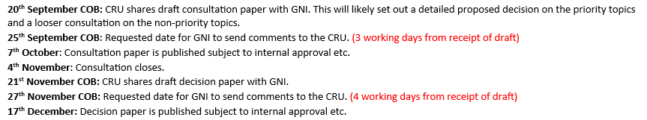
Timeline for the Core Flexibility Report development
30th June 2023: CEPA recommendations for CRU
20th December 2023: CRU Decision Paper on PC5 Regulatory Framework
Q2 2024 - Present:
GNI Framework development
16th December 2024:
CRU Decision on Price Control 5 Regulatory Framework Implementation
Q4 2024 – Q4 2025:
GNI Framework Implementation and final report

Slide 8
What has been asked of GNI to deliver in an adaptive planning report?
Ambition
The report is tied to a clear and unified underlying gas network strategy.
Scenario
A set of well justified supply and demand scenarios for the gas network based on energy policy and industry developments, min. 10-15 year outlook.
Pathways
A list of trigger and decision points that would cause GNI to change the central plan, along with proposed changes to the core pathway.
Monitoring
Engagement
GNI consider whole system implications of the adaptive pathways, with meaningful stakeholder engagement.
Define milestones to monitor trigger points and metrics to evaluate GNI’s adaptive planning performance.
A clear list of assumptions.
A demonstration of low regrets investments for the gas network based on adaptve pathways, producing a central plan.

Slide 9
Summary CFR Roadmap
2. Adaptive Planning Adoption
Start to build capability and embed adaptive planning processes to ultimately develop the first issue of the Core Flexibility Report
OUTPUT: CORE FLEXIBILITY REPORT
First Issue
3. Institutionalise Adaptive Planning Best Practice
Continue to embed adaptive planning processes across the organisation, seeking a consistent application of the processes. Align Core Flexibility Report with next iteration of Network Development Plan (2026).
OUTPUT: SUPPLEMENTAL FLEXIBILITY REPORT
2025
2026
5. Future Horizons
Seek opportunities to increase the maturity of the adaptive planning process across GNI, for example moving into a position of agile responses to external triggers & the application of market context in decision making processes .
OUTPUT: CORE FLEXIBILITY REPORT
Future Iterations – Developing Maturity & Complexity
2024
2027
:
1. Adaptive Planning Foundations
Develop adaptative planning processes, building upon current GNI practice, and achieve buy-in from CRU & GNI Leadership on the approach to develop the first Core Flexibility Report.
OUTPUT: CORE FLEXIBILITY REPORT Outline Plan
4. Drive Value & Sector Coupling
Work to align further with EirGrid, particularly expanding the ambition & scope from the first issue of the report with full suite of scenarios & pathways for Future State.
OUTPUT: CORE FLEXIBILITY REPORT
Second Issue
2027+
Notes:
Here is the proposed roadmap, detailing an incremental, year-on-year development of the Adaptive Planning Process and also sets the ambition for developing a buildable Core Flexibility, which will continue to mature and increase in complexity over time.​
Proposed incremental roadmap steps are as follows: ​
2024 - Adaptive Planning Foundations & Outline Plan for Core Flexibility Report​
2025 - Adaptive Planning Adoption & First Issue of Core Flexibility Report​
2026 - Institutionalise Adaptive Planning Best Practice & Supplemental Flexibility Report​
2027 – Drive Value and Sector Coupling & Second Issue of Core Flexibility Report​
2027+ - Adaptive Planning Future Horizons & Future Iterations of Core Flexibility Report​

Slide 10
GNI Core Flexibility Report
Approach

Slide 11
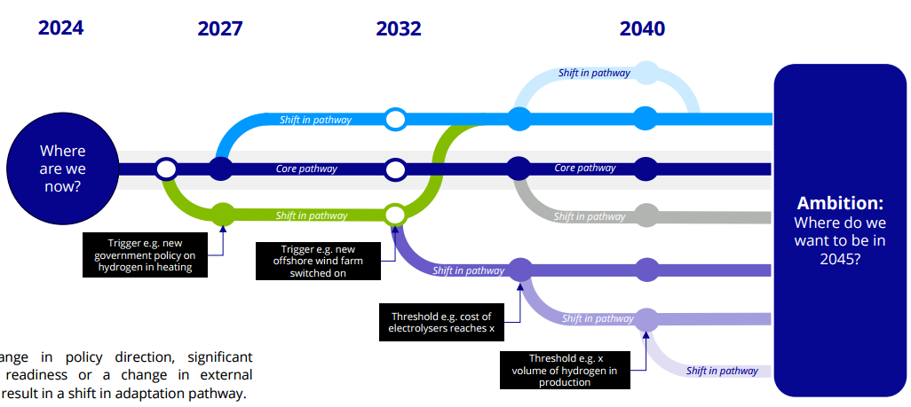
What is adaptive planning?
Adaptive Planning is an iterative framework for decision-making in uncertainty.
  Avoids commitment to one single long-term plan.
  Allows for flexibility to switch between actions creating a strategy that can evolve over time.
Adaptive Pathways are a specific adaptive planning approach to achieve the long-term strategy or goal.
  Takes various forms, but typically based on a decision tree with thresholds and trigger points.
  Each route in a decision tree forms an adaptive pathway that can be implemented as conditions evolve.
  Relies on monitoring and evaluation of conditions and trigger points over time.
Notes:
The ambition for this study is to recommend an appropriate adaptive planning process that GNI can embed across its business over the coming years in accordance with current best practice.We have undertaken desk research, structured interviews with key GNI personnel, and bespoke workshops to gain insights into GNI’s current strategies, and to co-create and inform an adaptive planning framework, carry out a maturity assessment and develop a roadmap for future recommendations.
Examples of People pillar:
Clarifying roles and responsibilities
Engaging stakeholders
Upskilling staff
Examples of Process pillar:
Structured planning
Refinement of internal processes
Example of Technology pillar:
Leverage existing tools
Set up of data sharing space and protocols.

Slide 12
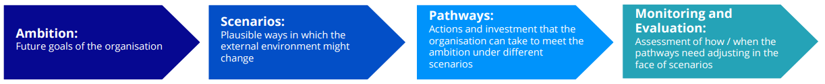
Adaptive Planning Steps
Assessment of how / when the pathways need adjusting in the face of trigger points
Scenarios:
    Plausible futures, yet extreme scenarios that an organisation must be resilient and adaptable to.
Pathways:
    Core pathway: Actions and investments taken to meet ambition under current conditions.
    Alternative pathway: Actions and investments taken to meet ambition under different scenarios.
    Helps identify low- and no-regret actions and investments
Notes:
The ambition for this study is to recommend an appropriate adaptive planning process that GNI can embed across its business over the coming years in accordance with current best practice.We have undertaken desk research, structured interviews with key GNI personnel, and bespoke workshops to gain insights into GNI’s current strategies, and to co-create and inform an adaptive planning framework, carry out a maturity assessment and develop a roadmap for future recommendations.
Examples of People pillar:
Clarifying roles and responsibilities
Engaging stakeholders
Upskilling staff
Examples of Process pillar:
Structured planning
Refinement of internal processes
Example of Technology pillar:
Leverage existing tools
Set up of data sharing space and protocols.

Slide 13
What are trigger points?
Trigger Points
  The conditions under which a decision must be made to move/shift to an alternative pathway. For example:
    Delay in delivering offshore wind capacity targets
    Operation support schemes for produciton of biomethane
    New government policy e.g. hydrogen in heating
  Decisions to shift to an alternative pathway or stay on current pathway based on specific trigger points.
Notes:
The ambition for this study is to recommend an appropriate adaptive planning process that GNI can embed across its business over the coming years in accordance with current best practice.We have undertaken desk research, structured interviews with key GNI personnel, and bespoke workshops to gain insights into GNI’s current strategies, and to co-create and inform an adaptive planning framework, carry out a maturity assessment and develop a roadmap for future recommendations.
Examples of People pillar:
Clarifying roles and responsibilities
Engaging stakeholders
Upskilling staff
Examples of Process pillar:
Structured planning
Refinement of internal processes
Example of Technology pillar:
Leverage existing tools
Set up of data sharing space and protocols.

Slide 14
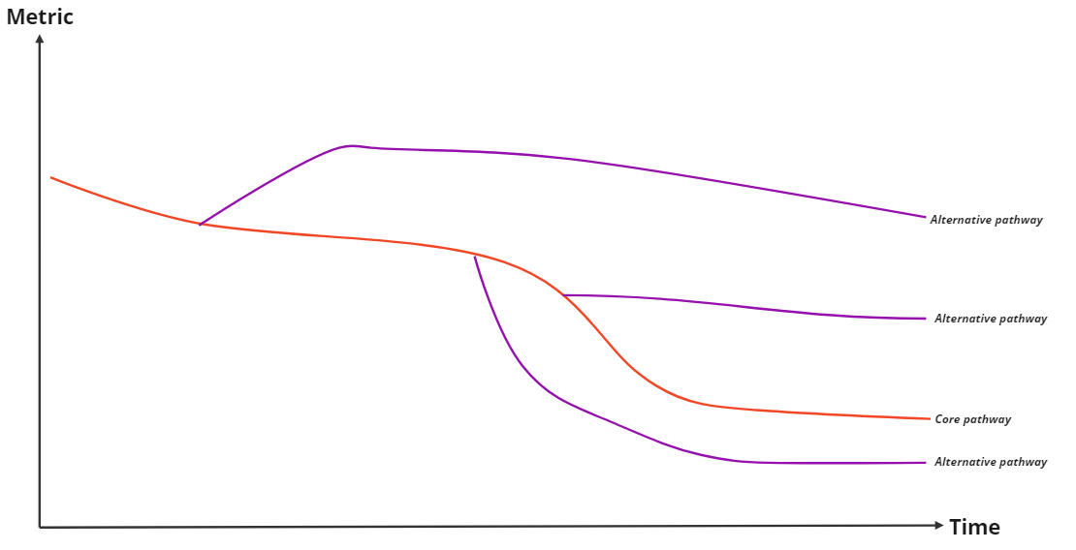
Phase 1 approach for Adaptive Planning
Core pathway will be linked to GNI strategy.
  Short- to medium-term will be aligned with Best Estimate scenario from the Network Development Plan
  Medium- to long-term will be aligned with Pathway to a Net Zero Carbon Network strategy adapted for National Hydrogen Strategy
Trigger points to identify alternative pathways off core pathway only
Pathways associated 2-3 alternative scenarios

Slide 15
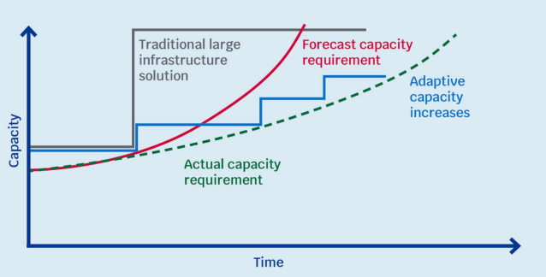
What is the benefit of adaptive planning?
The aim of adaptive planning is more robust long-term planning with more focus on low regret investments.
“Adaptive planning can facilitate the delivery of solutions that more closely reflect what later turns out to be required than building large infrastructure now on the basis of uncertain assumptions about the future.”
  Ofwat – Long Term Delivery Strategy
Source: Ofwat – Long Term Delivery Strategy
Notes:
It may be the case that a large infrastructure solution is likely to be the most efficient solution, even if it goes beyond the actual capacity requirement in the near term. This possibility is not ruled out by adaptive planning. However, adaptive planning gives the opportunity to explore options to meet long-term outcomes using flexible, modular or adaptive solutions where possible and efficient to do so. These solutions can later be expanded as new information arises and there is a higher level of certainty around the impact of external factors.

Slide 16
Modelling Approach and Material for Consultation

Slide 17


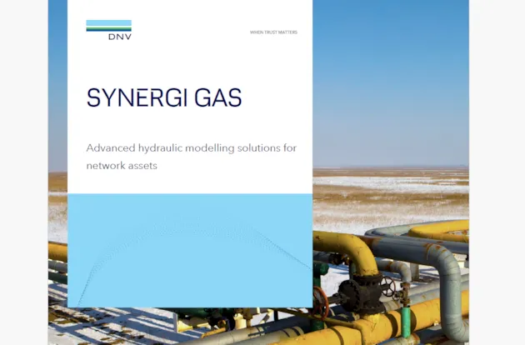
Holistic energy system approach
Step 1: Defining the Scenarios
Step 2: Model building
Step 3: System needs assessment
Input Parameters
Ambition
Trigger Points
Scenarios
Natural gas / Biomethane
Electricity
Transmission
Distribution
Hydrogen
Natural gas / Biomethane
Natural gas / Biomethane
Hydrogen
Core & Alternative Pathways
Notes:
Core & Alternative Pathways...
Step 1
Step 2
Step 3
Core & Alternative Pathways...

Slide 18
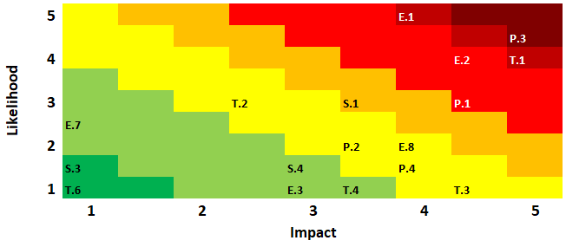
Feedback on identified trigger points
GNI are seeking feedback from stakeholders on identified trigger points, specifically relating to developments within:
  Policy direction
  Economic developments
  Social aspects
  Technology advancements
  Legal issues
  Environmental concerns
Triggers points will be used to identify, model and analyse alternative pathways. Priority to highest rated trigger points (in terms of impact and likelihood).
To this end, you should have received a questionnaire “GNI Trigger points for adaptive planning” where you can provide your own assessment of relevant trigger points and provide any additional feedback to any given trigger point.

Slide 19
Feedback on Modelling input parameters
TYNDP 2024 data
SEM data
DEA Technology catalogue
CFR input parameters for long-term model
GNI are seeking feedback from stakeholders on technical and economic inputs to our model, specifically relating to:
  Hydrogen production
  Biomethane production
  Renewable electricity capacity and generation
  Thermal electricity generation
  Energy storage
  Energy infrastructure
  Carbon capture and storage (CCS)
  Fuel costs and emission factors
To this end, you should have received a questionnaire “GNI Input parameters for model building” where you can provide your feedback and comments on the proposed input values chosen.

Slide 20
Next steps

Slide 21
High level timeline for first iteration
Q2-Q4 2024
Framework
Q4 2024 – Q2 2025
Core & alternative pathway development
Q2-Q3 2025
System needs assessment
Q3 2025:
Drafting main report
Q4 2025
Internal approval & public consultation
Q1 2026:
Reflection & feedback
Q2 2026:
2027 cycle start-up
Q1 2026:
Final publication
Notes:
Final publication is expected in January 2026

Slide 22
What is to be expected in coming time?
14th January 2025:
Webinar on GNI’s plans to deliver adaptive planning.
Mid to Late January:
Individual meetings with key stakeholders to discuss feedback.
31st January 2025
Deadline for feedback on trigger points and model input parameters.
Late December 2024:
Sending out questionnaires on trigger points and modelling input parameters.
End 2025
30 day public consultation on CFR draft report.

Slide 23
Q&A Session

Slide 24
Thank you for joining!
Core Flexibility query: networkforecasting@gasnetworks.ie
General query: stakeholder@gasnetworks.ie

